Slide 1
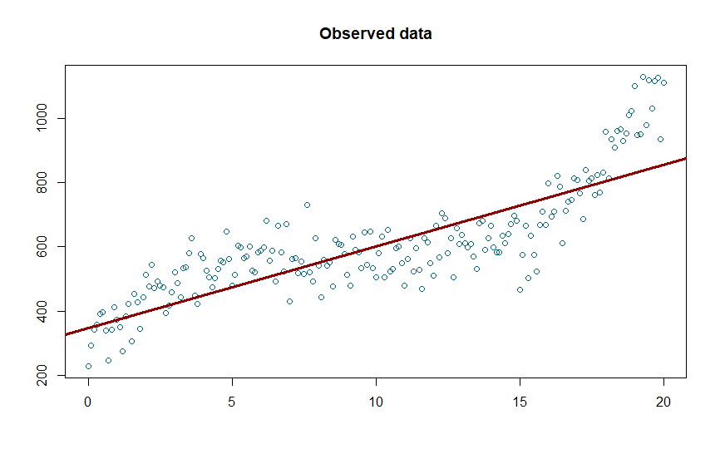
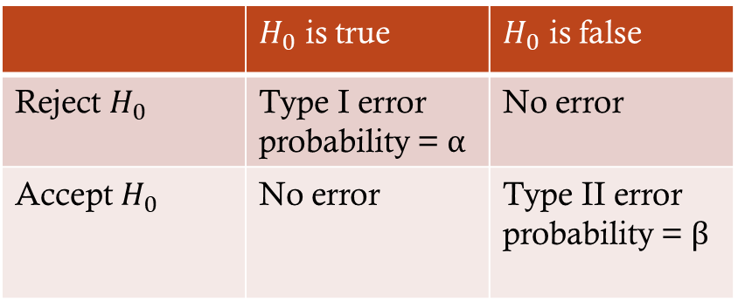
xy=n∑xiyi−∑xi∑yi√n∑x2i−(∑xi)2 √n∑y2i−(∑yi)2
 | $H_{0}$ is true | $H_{0}$ is false
Reject $H_{0}$ | Type I error probability = α | No error
Accept $H_{0}$ | No error | Type II error probability = β
x | y
1 | 4
2 | 6
3 | 7
4 | 9
5 | 10
6 | ?

Slide 2
Mean or Median?

Slide 3
Mean or Median?
When to use which?

Slide 4
Mean or Median?
When to use which?
Skewness / Symmetrie

Slide 5
Mean or Median?
Example: Product price

Slide 6
Mean or Median?
Example: Product price
Price
21
4
9
14
29
2
194

Slide 7
Mean or Median?
Example: Product price
Price
21
4
9
14
29
2
194
Mean = 39

Slide 8
Mean or Median?
Example: Product price
Price
21
4
9
14
29
2
194
Mean = 39

Slide 9
Mean or Median?
Example: Product price
Price
21
4
9
14
29
2
194
Mean = 39
Median = 14

Slide 10
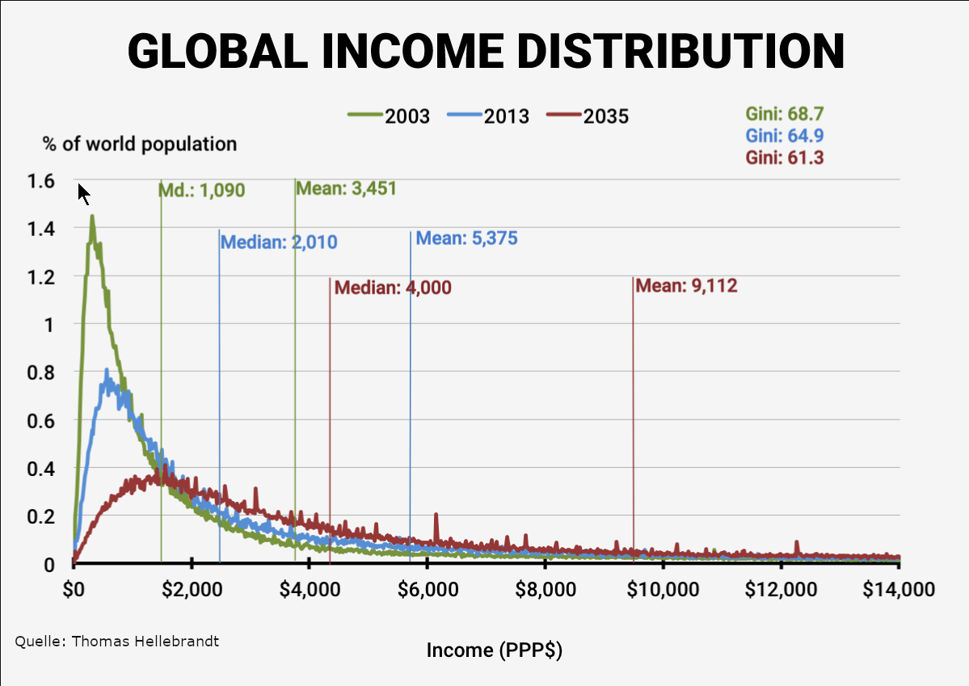
Mean or Median?
Example: Product price
Price
21
4
9
14
29
2
194
Mean = 39
Median = 14

Slide 11
Mean vs. Median vs. Mode

Slide 12
Mean vs. Median vs. Mode

Slide 13
Mean or Median?
Mean sensitive towords outliers (asymmetrical datasets)

Slide 14
Mean or Median?
Mean sensitive towords outliers (asymmetrical datasets)
Median less sensitive towards outliers
Mode for categorical values
Alternative / Complementary

Slide 15
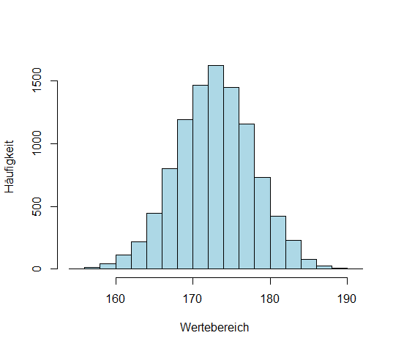
Skewness
Frequency
values

Slide 16
Skewness
Frequency
values

Slide 17
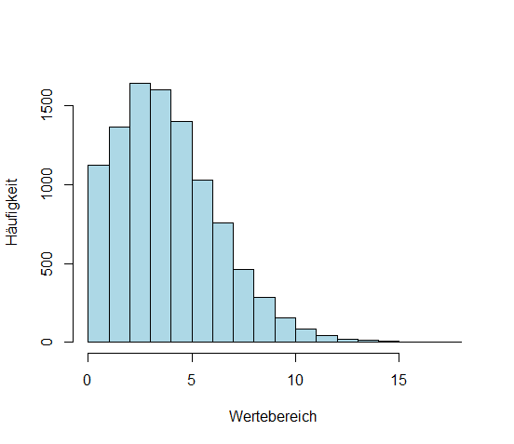
Skewness
positive skew
Frequency
values

Slide 18
Skewness
Frequency
values

Slide 19
Skewness
Frequency
values

Slide 20
Skewness
Mode
Median
< <
Mean
Frequency
values

Slide 21
Skewness
Mode
Median
< <
Mean
positive skew (right-skewed)
Frequency
values

Slide 22

Skewness
< <
Mean
Median
Mode
$$\frac{5}{36}$$
Frequency
negative skew (left-skewed)
values

Slide 23
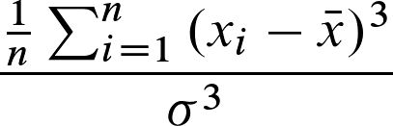
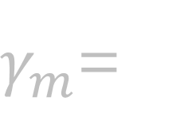
Skewness
Calculation of the Skewness:
Mean
Mode
< <
Median
$γ_{m}$=
Frequency
values

Slide 24
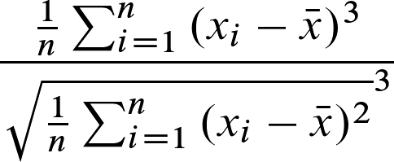

Skewness
Calculation of the Skewness:
Mean
Mode
< <
Median
$γ_{m}$=
Frequency
values

Slide 25
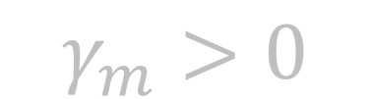
Skewness
Calculation of the Skewness:
Mean
Mode
< <
Median
$γ_{m}$=
Frequency
$$γ_{m}>0$$
positive skew (right-skewed)
values

Slide 26
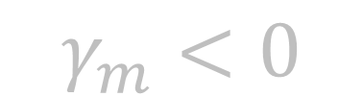
Skewness
Calculation of the Skewness:
Mean
Mode
< <
Median
$γ_{m}$=
Frequency
$$γ_{m}>0$$
positive skew (right-skewed)
$$γ_{m}<0$$
negative skew (left-skewed)
values

Slide 27
Skewness
Number of people
1
2
2
1
3
4
3
2
5
1
2
7
3
4
5
6
2
1

Slide 28
Skewness
Number of people
1
2
2
1
3
4
3
2
5
1
2
7
3
4
5
6
2
1

Slide 29
Skewness
Number of people
1
2
2
1
3
4
3
2
5
1
2
7
3
4
5
6
2
1

Slide 30
Skewness
Number of people
1
2
2
1
3
4
3
2
5
1
2
7
3
4
5
6
2
1
right-skewed (positive skew)

Slide 31
Skewness
Number of people
1
2
2
1
3
4
3
2
5
1
2
7
3
4
5
6
2
1
Mode
right-skewed (positive skew)

Slide 32
Skewness
Number of people
1
2
2
1
3
4
3
2
5
1
2
7
3
4
5
6
2
1
Mode
Median
right-skewed (positive skew)

Slide 33
Skewness
Number of people
1
2
2
1
3
4
3
2
5
1
2
7
3
4
5
6
2
1
Mode
Median
Mean
right-skewed (positive skew)

Slide 34
Skewness
Number of people
1
2
2
1
3
4
3
2
5
1
2
7
3
4
5
6
2
1
<
<
Mode
Median
Mean
right-skewed (positive skew)

Slide 35
Skewness
Number of people
1
2
2
1
3
4
3
2
5
1
2
7
3
4
5
6
2
1
<
<
<
<
Mode
Median
Mean
right-skewed (positive skew)
right-skewed (positive skew)

Slide 36
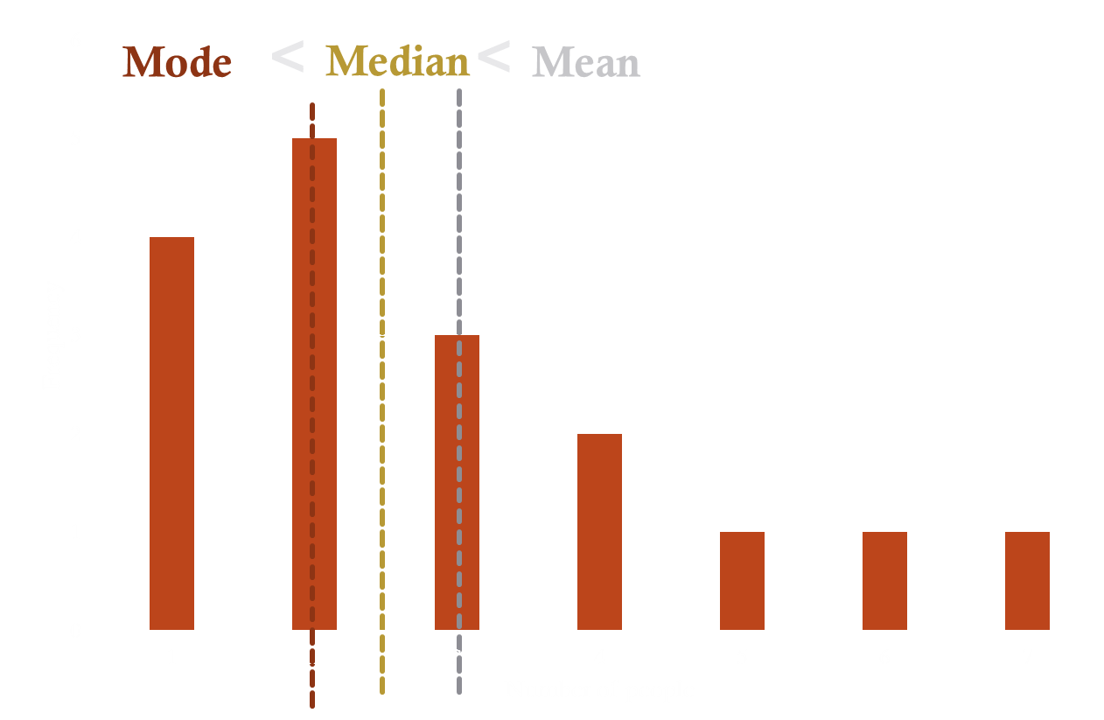
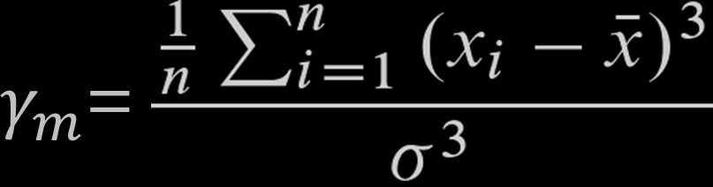
Skewness
Number of people
1
2
2
1
3
4
3
2
5
1
2
7
3
4
5
6
2
1

Slide 37
Skewness
Number of people
1
2
2
1
3
4
3
2
5
1
2
7
3
4
5
6
2
1

Slide 38
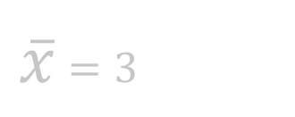
Skewness
Number of people
1
2
2
1
3
4
3
2
5
1
2
7
3
4
5
6
2
1
$\overline{x}$ $=3$

Slide 39
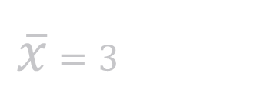

Skewness
Number of people
1
2
2
1
3
4
3
2
5
1
2
7
3
4
5
6
2
1
$\overline{x}$ $=3$
$$5.48 ≈$$

Slide 40

Skewness
Number of people
1
2
2
1
3
4
3
2
5
1
2
7
3
4
5
6
2
1
$$4$$
$\overline{x}$ $=3$
$$5.48 ≈$$

Slide 41

Skewness
Number of people
1
2
2
1
3
4
3
2
5
1
2
7
3
4
5
6
2
1
$$4$$
$$5.48$$
$\overline{x}$ $=3$
$$5.48 ≈$$

Slide 42
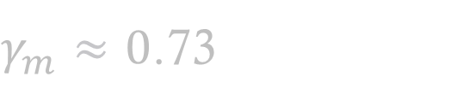
Skewness
Number of people
1
2
2
1
3
4
3
2
5
1
2
7
3
4
5
6
2
1
$$4$$
$$5.48$$
$\overline{x}$ $=3$
$γ_{m}≈0$.73
$$5.48 ≈$$

Slide 43
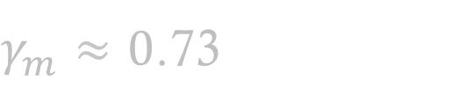
Skewness
Number of people
1
2
2
1
3
4
3
2
5
1
2
7
3
4
5
6
2
1
$$4$$
$$5.48$$
$\overline{x}$ $=3$
$$5.48 ≈$$
$γ_{m}≈0$.73

Slide 44
Example
You will be analyzing the sales of the last months for a kiosk chain.
revenue
20 000
35 000
80 000
12 000
4 000
9 000
350 000
23 000
48 000
100 000
950 000
33 000
11 000

Slide 45
Exercise
You will be analyzing the sales of the last months for a kiosk chain.
revenue
20 000
35 000
80 000
12 000
4 000
9 000
350 000
23 000
48 000
100 000
950 000
33 000
11 000
Calculate the Mean.
Calculate the Median.
Calculate the Skewness.

Slide 46
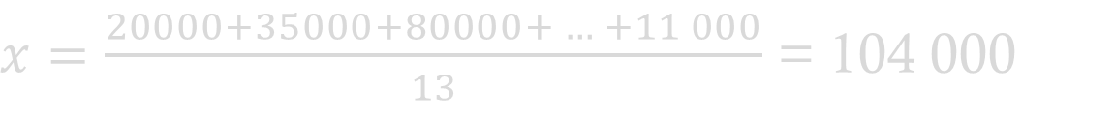
Solution
You will be analyzing the sales of the last months for a kiosk chain.
Calculate the Mean.
revenue
20 000
35 000
80 000
12 000
4 000
9 000
350 000
23 000
48 000
100 000
950 000
33 000
11 000
$x=\frac{20000+35000+80000+ … +11 000}{13}$ = 104 000

Slide 47
Solution
You will be analyzing the sales of the last months for a kiosk chain.
2. Calculate the Median.
revenue
20 000
35 000
80 000
12 000
4 000
9 000
350 000
23 000
48 000
100 000
950 000
33 000
11 000

Slide 48
Solution
You will be analyzing the sales of the last months for a kiosk chain.
2. Calculate the Median.
revenue
20 000
35 000
80 000
12 000
4 000
9 000
350 000
23 000
48 000
100 000
950 000
33 000
11 000
revenue
4 000
9 000
11 000
12 000
20 000
23 000
33 000
35 000
48 000
80 000
100 000
350 000
950 000

Slide 49
Solution
You will be analyzing the sales of the last months for a kiosk chain.
2. Calculate the Median.
revenue
20 000
35 000
80 000
12 000
4 000
9 000
350 000
23 000
48 000
100 000
950 000
33 000
11 000
revenue
4 000
9 000
11 000
12 000
20 000
23 000
33 000
35 000
48 000
80 000
100 000
350 000
950 000
Median = 33 000

Slide 50
Solution
3. Calculate the Skewness.
You will be analyzing the sales of the last months for a kiosk chain.
revenue
20 000
35 000
80 000
12 000
4 000
9 000
350 000
23 000
48 000
100 000
950 000
33 000
11 000

Slide 51
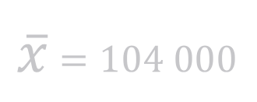

Solution
3. Calculate the Skewness.
You will be analyzing the sales of the last months for a kiosk chain.
revenue
20 000
35 000
80 000
12 000
4 000
9 000
350 000
23 000
48 000
100 000
950 000
33 000
11 000
$\overline{x}$ $=104 000$
$σ$ $≈263232$

Slide 52


Solution
3. Calculate the Skewness.
You will be analyzing the sales of the last months for a kiosk chain.
revenue
20 000
35 000
80 000
12 000
4 000
9 000
350 000
23 000
48 000
100 000
950 000
33 000
11 000
revenue
4 000
9 000
11 000
12 000
20 000
23 000
33 000
35 000
48 000
80 000
100 000
350 000
950 000
$$42 520 359 496 000 000$$
$$18 239 631 104 000 000$$
$\overline{x}$ $=104 000$
$σ$ $≈263232$

Slide 53
Solution
3. Calculate the Skewness.
You will be analyzing the sales of the last months for a kiosk chain.
revenue
20 000
35 000
80 000
12 000
4 000
9 000
350 000
23 000
48 000
100 000
950 000
33 000
11 000
revenue
4 000
9 000
11 000
12 000
20 000
23 000
33 000
35 000
48 000
80 000
100 000
350 000
950 000
$$42 520 359 496 000 000$$
$$18 239 631 104 000 000$$
$\overline{x}$ $=104 000$
$σ$ $≈263232$

Slide 54

Solution
3. Calculate the Skewness.
You will be analyzing the sales of the last months for a kiosk chain.
revenue
20 000
35 000
80 000
12 000
4 000
9 000
350 000
23 000
48 000
100 000
950 000
33 000
11 000
revenue
4 000
9 000
11 000
12 000
20 000
23 000
33 000
35 000
48 000
80 000
100 000
350 000
950 000
$$≈2.33$$
$\overline{x}$ $=104 000$
$σ$ $≈263232$

Slide 55
Solution
3. Calculate the Skewness.
You will be analyzing the sales of the last months for a kiosk chain.
revenue
20 000
35 000
80 000
12 000
4 000
9 000
350 000
23 000
48 000
100 000
950 000
9 000
33 000
11 000

Slide 56
Exercise
For the marketing department you are supposed to analyze as an analyst the profitability of the campaigns in the last 20 weeks.
The head of department has the attitude to choose a strategy that is as profitable as possible. However, since the company is currently experiencing somewhat difficult times, she does not want to take a particularly large risk.
Strategy 1
3797
380
7120
4200
4122
3926
-132
-371
-283
-1011
4565
1637
1745
-1193
2628
3055
2391
4781
5067
540
Strategy 2
3993
2284
3056
2997
1771
2943
3475
3228
3436
-94
3429
2601
3945
101
1367
3040
677
3667
1083
4061
Strategy 3
1927
960
1136
1302
661
1385
340
116
2003
1485
1691
280
1458
1716
-158
758
1560
114
3439
823
Calculate for these data the Means
and the variances.
Based on these two measures,
which strategy would you advise the
marketing department?

Slide 57
Solution
For the marketing department you are supposed to analyze as an analyst the profitability of the campaigns in the last 20 weeks.
The head of department has the attitude to choose a strategy that is as profitable as possible. However, since the company is currently experiencing somewhat difficult times, she does not want to take a particularly large risk.
Strategy 1
3797
380
7120
4200
4122
3926
-132
-371
-283
-1011
4565
1637
1745
-1193
2628
3055
2391
4781
5067
540
Strategy 2
1993
2284
1056
2997
1771
2943
2475
3228
3436
-94
3429
2601
3945
101
1367
3040
677
3667
1083
4061
Strategy 3
1927
960
1136
1302
661
1385
340
116
2003
1485
1691
280
1458
1716
-158
758
1560
114
3439
823
Mean: Standard deviation:
Strategy 1: 2348.2 2351.309
Strategy 2: 2303.5 1260.056
Strategy 3: 1149.8 841.044

Slide 58
Solution
For the marketing department you are supposed to analyze as an analyst the profitability of the campaigns in the last 20 weeks.
The head of department has the attitude to choose a strategy that is as profitable as possible. However, since the company is currently experiencing somewhat difficult times, she does not want to take a particularly large risk.
Strategy 1
3797
380
7120
4200
4122
3926
-132
-371
-283
-1011
4565
1637
1745
-1193
2628
3055
2391
4781
5067
540
Strategy 2
1993
2284
1056
2997
1771
2943
2475
3228
3436
-94
3429
2601
3945
101
1367
3040
677
3667
1083
4061
Strategy 3
1927
960
1136
1302
661
1385
340
116
2003
1485
1691
280
1458
1716
-158
758
1560
114
3439
823
Mean: Standard deviation:
Strategy 1: 2348.2 2351.309
Strategy 2: 2303.5 1260.056
Strategy 3: 1149.8 841.044

Slide 59
Practise
You work as a business analyst in a sports company that sells sports shoes.For our customer group, we know that the fitting shoe length is normally distributed with µ= 27 cm and 𝜎 = 2.5cm.
Now we want to choose betwen 2 variants for the model that fits more people:
Model A: Fits for shoe length range: 27.1cm - 27.6cm
Model B: Fits for shoe length range : 26.7cm - 27.1cm
What percentage of our customers fit each shoe model?

Slide 60
Practise
Du arbeitest als Business Analyst in einem Sport-Unternehmen, das Sportschuhe vertreibt.
Für unsere Kundengruppe wissen wir, dass die passende Schuhlänge normalverteilt ist mit µ= 27 cm und 𝜎 = 2.5cm.
Wir wollen uns jetzt zwischen 2 Varianten für das Modell entscheiden, das mehr Leuten passt:
Modell A: Passend für Schuhlängen-Bereich: 27.1cm – 27.6cm
Modell B: Passend für Schuhlängen-Bereich: 26.7cm – 27.1cm
Wie viel Prozent unserer Kunden passt jeweils welches Schuh-Modell?

Slide 61
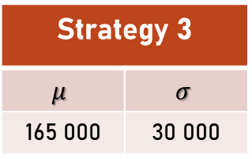
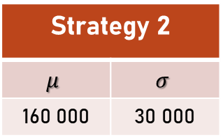
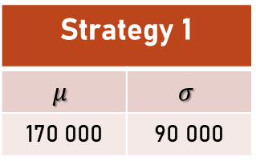
Exercise
You are again to support and advise the marketing department as an analyst or analyst.
Die Marketingabteilung hat in diesem Jahr bereits 840 000$ erwirtschaftet (Jan – Nov).
Beim Erreichen von 1 Mio $ in dem Jahr gibt es einen Bonus.
Für den letzten Monat des Jahres soll die Strategy gewählt werden, die die höchste Wahrscheinlichkeit für das Erreichen des Bonus hat (1 Mio $) hat.
Aus historischen Daten ist bekannt, dass die Umsätze der drei Stragien normalverteilt mit folgenden Parametern sind:
Strategy 1
$$μ$$ | $$σ$$
170 000 | 90 000
Strategy 2
$$μ$$ | $$σ$$
160 000 | 30 000
Strategy 3
$$μ$$ | $$σ$$
165 000 | 30 000
Which strategy do you suggest?

Slide 62
Solution
You are again to support and advise the marketing department as analyst.
The marketing department has already generated 840 000$ this year (Jan - Nov). When reaching 1 Mio $ in the year there is a bonus.
For the last month of the year, the strategy that has the highest probability of reaching the bonus ($1 million) should be chosen.
From historical data it is known that the sales of the three strategies are normally distributed with the following parameters:
Strategy 1
$$μ$$ | $$σ$$
170 000 | 90 000
Strategy 2
$$μ$$ | $$σ$$
160 000 | 30 000
Strategy 3
$$μ$$ | $$σ$$
165 000 | 30 000
Which strategy do you suggest?

Slide 63
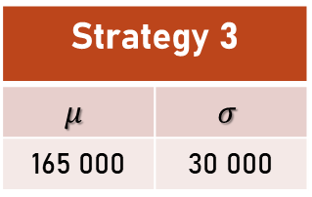
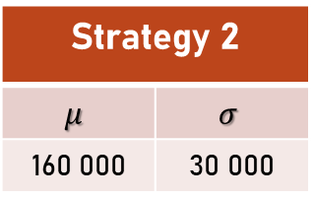
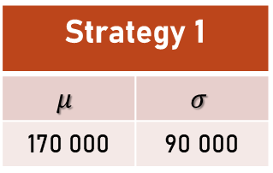
Solution
You are again to support and advise the marketing department as analyst.
The marketing department has already generated 840 000$ this year (Jan - Nov). When reaching 1 Mio $ in the year there is a bonus.
For the last month of the year, the strategy that has the highest probability of reaching the bonus ($1 million) should be chosen.
From historical data it is known that the sales of the three strategies are normally distributed with the following parameters:
Strategy 1
$$μ$$ | $$σ$$
170 000 | 90 000
Strategy 2
$$μ$$ | $$σ$$
160 000 | 30 000
Strategy 3
$$μ$$ | $$σ$$
165 000 | 30 000
Which strategy do you suggest?

Slide 64
Solution
You are again to support and advise the marketing department as analyst.
The marketing department has already generated 840 000$ this year (Jan - Nov). When reaching 1 Mio $ in the year there is a bonus.
For the last month of the year, the strategy that has the highest probability of reaching the bonus ($1 million) should be chosen.
From historical data it is known that the sales of the three strategies are normally distributed with the following parameters:
Strategy 1
$$μ$$ | $$σ$$
170 000 | 90 000
Strategy 2
$$μ$$ | $$σ$$
160 000 | 30 000
Strategy 3
$$μ$$ | $$σ$$
165 000 | 30 000
Which strategy do you suggest?
Probability that at least $160 000 will be generated.

Slide 65
Solution
You are again to support and advise the marketing department as analyst.
The marketing department has already generated 840 000$ this year (Jan - Nov). When reaching 1 Mio $ in the year there is a bonus.
For the last month of the year, the strategy that has the highest probability of reaching the bonus ($1 million) should be chosen.
From historical data it is known that the sales of the three strategies are normally distributed with the following parameters:
Strategy 1
$$μ$$ | $$σ$$
170 000 | 90 000
Strategy 2
$$μ$$ | $$σ$$
160 000 | 30 000
Strategy 3
$$μ$$ | $$σ$$
165 000 | 30 000
Which strategy do you suggest?
Probability that at least $160 000 will be generated.

Slide 66
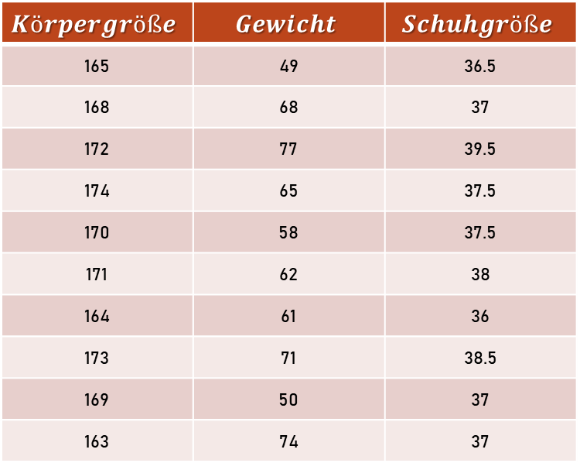
Korrelation
Du arbeitest als Data Analyst oder Data Analystin bei einem großen Schuh-Händler.
Das Produktteam möchte gerne eine neue Funktion auf der Homepage integrieren, die die passende Schuhgröße schätzt.
Im ersten Schritt sollst du mit Hilfe der Korrelation prüfen, ob das Gewicht oder die Körpergröße einen größeren Einfluss auf die Schuhgröße hat.
Die Korrelation zwischen Gewicht und Schuhgröße beträgt 0.59.
$$Körpergröße$$ | $$Gewicht$$ | $$Schuhgröße$$
165 | 49 | 36.5
168 | 68 | 37
172 | 77 | 39.5
174 | 65 | 37.5
170 | 58 | 37.5
171 | 62 | 38
164 | 61 | 36
173 | 71 | 38.5
169 | 50 | 37
163 | 74 | 37
Berechne die Korrelationen zwischen Körpergröße und Schuhgröße.

Slide 67
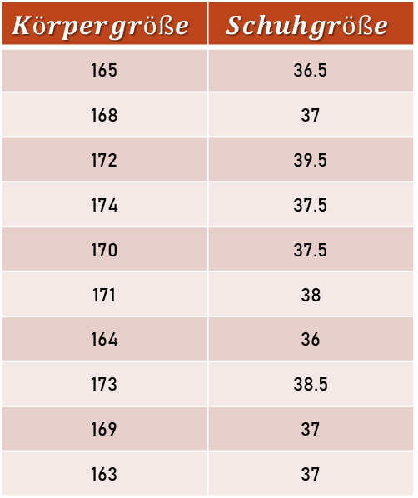
Korrelation
Du arbeitest als Data Analyst oder Data Analystin bei einem großen Schuh-Händler.
Das Produktteam möchte gerne eine neue Funktion auf der Homepage integrieren, die die passende Schuhgröße schätzt.
Im ersten Schritt sollst du mit Hilfe der Korrelation prüfen, ob das Gewicht oder die Körpergröße einen größeren Einfluss auf die Schuhgröße hat.
Die Korrelation zwischen Gewicht und Schuhgröße beträgt 0.59.
$$Körpergröße$$ | $$Schuhgröße$$
165 | 36.5
168 | 37
172 | 39.5
174 | 37.5
170 | 37.5
171 | 38
164 | 36
173 | 38.5
169 | 37
163 | 37
Korrelation = 0.741

Slide 68
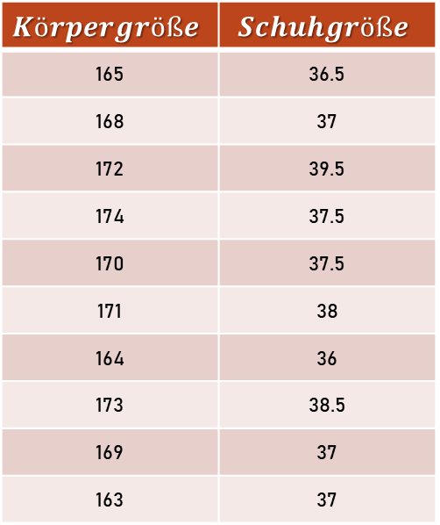
Korrelation
Zur Schätzung der Schuhgröße soll eine Regression über die Körpergröße erstellt werden.
$$Körpergröße$$ | $$Schuhgröße$$
165 | 36.5
168 | 37
172 | 39.5
174 | 37.5
170 | 37.5
171 | 38
164 | 36
173 | 38.5
169 | 37
163 | 37
Berechne die Regressionsgerade.
Wie wird die Schuhgröße für eine Person mit einer Größe von 168cm geschätzt?

Slide 69
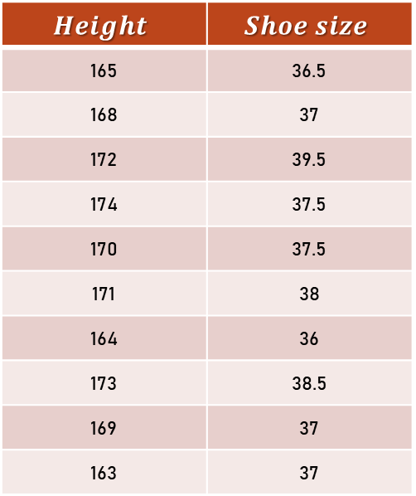
Correlation
You work as a Data Analyst at a large shoe retailer.
The product team would like to integrate a new feature on the homepage that estimates the appropriate shoe size.
In the first step, you are to use correlation to check whether weight or height has a greater impact on shoe size.
The correlation between weight and shoe size is 0.59.
$$Height$$ | $$Shoe size$$
165 | 36.5
168 | 37
172 | 39.5
174 | 37.5
170 | 37.5
171 | 38
164 | 36
173 | 38.5
169 | 37
163 | 37
Calculate the correlation between height and shoe size.

Slide 70
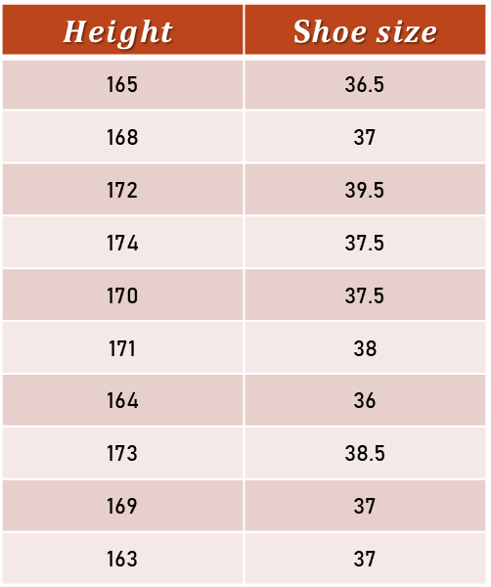
Correlation
You work as a Data Analyst at a large shoe retailer.
The product team would like to integrate a new feature on the homepage that estimates the appropriate shoe size.
In the first step, you are to use correlation to check whether weight or height has a greater impact on shoe size.
The correlation between weight and shoe size is 0.59.
$$Height$$ | S$hoe size$
165 | 36.5
168 | 37
172 | 39.5
174 | 37.5
170 | 37.5
171 | 38
164 | 36
173 | 38.5
169 | 37
163 | 37
Correlation = 0.741

Slide 71
Correlation
To estimate the shoe size, a regression on body size should be created.
$$Körpergröße$$ | $$Schuhgröße$$
165 | 36.5
168 | 37
172 | 39.5
174 | 37.5
170 | 37.5
171 | 38
164 | 36
173 | 38.5
169 | 37
163 | 37
Calculate the regression line.
What is the shoe size estimated for a person with a height of 168cm?

Slide 72
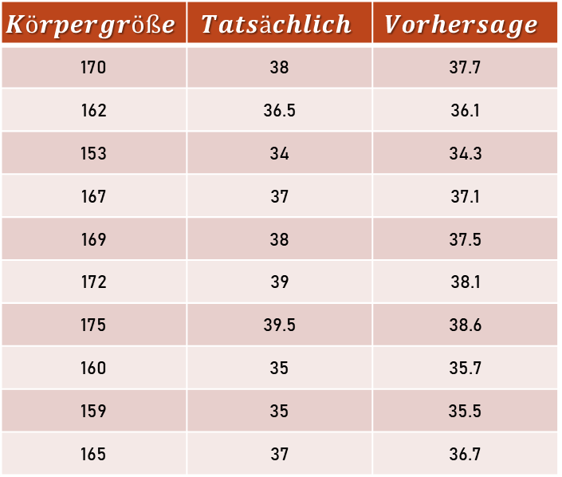
MSE & MAE
Um die Genauigkeit der Regression zu prüfen benutzen wir nun einen anderen Datensatz und berechnen den MSE (mittleren quadratischen Fehler) sowie den MAE (mittleren absoluten Fehler).
$$Körpergröße$$ | $$Tatsächlich$$ | $$Vorhersage$$
170 | 38 | 37.7
162 | 36.5 | 36.1
153 | 34 | 34.3
167 | 37 | 37.1
169 | 38 | 37.5
172 | 39 | 38.1
175 | 39.5 | 38.6
160 | 35 | 35.7
159 | 35 | 35.5
165 | 37 | 36.7
Berechne für den neuen Datensatz den MSE & MAE.

Slide 73
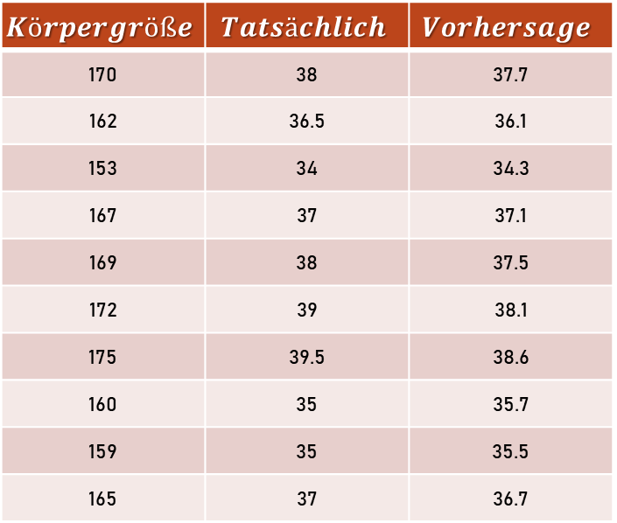
MSE & MAE
Um die Genauigkeit der Regression zu prüfen benutzen wir nun einen anderen Datensatz und berechnen den MSE (mittleren quadratischen Fehler) sowie den MAE (mittleren absoluten Fehler).
$$Körpergröße$$ | $$Tatsächlich$$ | $$Vorhersage$$
170 | 38 | 37.7
162 | 36.5 | 36.1
153 | 34 | 34.3
167 | 37 | 37.1
169 | 38 | 37.5
172 | 39 | 38.1
175 | 39.5 | 38.6
160 | 35 | 35.7
159 | 35 | 35.5
165 | 37 | 36.7
MSE = 0.305
MAE = 0.49
Berechne für den neuen Datensatz den MSE & MAE.

Slide 74
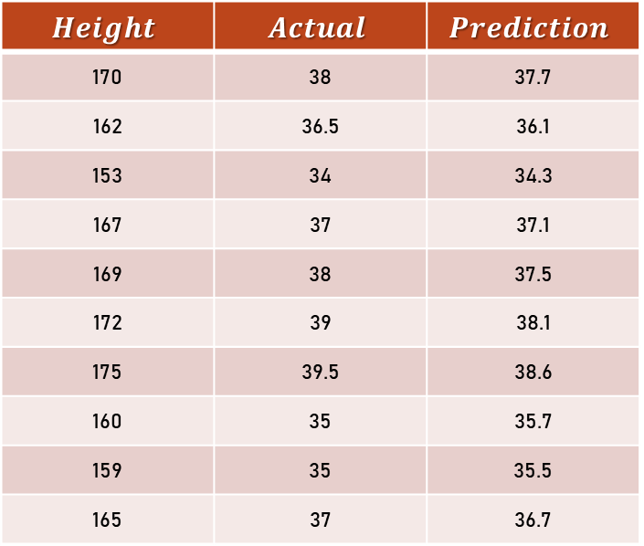
MSE & MAE
To check the accuracy of the regression we now use a different data set and calculate the MSE (mean square error) as well as the MAE (mean absolute error).
$$Height$$ | $$Actual$$ | $$Prediction$$
170 | 38 | 37.7
162 | 36.5 | 36.1
153 | 34 | 34.3
167 | 37 | 37.1
169 | 38 | 37.5
172 | 39 | 38.1
175 | 39.5 | 38.6
160 | 35 | 35.7
159 | 35 | 35.5
165 | 37 | 36.7
Calculate the MSE and MAE for this new dataset.

Slide 75
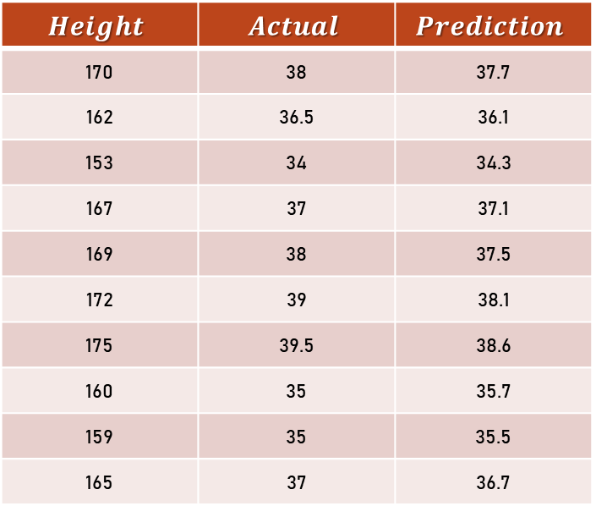
MSE & MAE
To check the accuracy of the regression we now use a different data set and calculate the MSE (mean square error) as well as the MAE (mean absolute error).
$$Height$$ | $$Actual$$ | $$Prediction$$
170 | 38 | 37.7
162 | 36.5 | 36.1
153 | 34 | 34.3
167 | 37 | 37.1
169 | 38 | 37.5
172 | 39 | 38.1
175 | 39.5 | 38.6
160 | 35 | 35.7
159 | 35 | 35.5
165 | 37 | 36.7
MSE = 0.305
MAE = 0.49
Calculate the MSE and MAE for this new dataset.

Slide 76
MSE & MAE
To check the accuracy of the regression we now use a different data set and calculate the MSE (mean square error) as well as the MAE (mean absolute error).
$$Height$$ | $$Actual$$ | $$Prediction$$
170 | 38 | 37.7
162 | 36.5 | 36.1
153 | 34 | 34.3
167 | 37 | 37.1
169 | 38 | 37.5
172 | 39 | 38.1
175 | 39.5 | 38.6
160 | 35 | 35.7
159 | 35 | 35.5
165 | 37 | 36.7
Berechne für den neuen Datensatz den MSE & MAE.

Slide 77
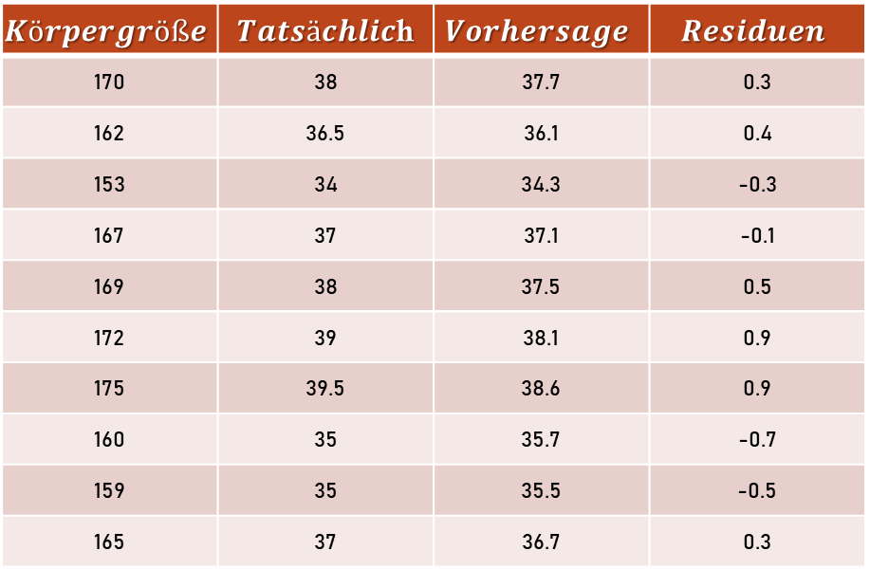
RMSE
Um etwas besser einschätzen zu können wie stark die Abweichung in der Praxis ist, soll auch der RMSE berechnet.
Diesem RMSE entsprechend, wie groß ist der Fehlerbereich in dem wir 68% (vgl. Empirische Regel) unserer Daten erwarten können?
$$Körpergröße$$ | $Tatsächlic$h | $$Vorhersage$$ | $$Residuen$$
170 | 38 | 37.7 | 0.3
162 | 36.5 | 36.1 | 0.4
153 | 34 | 34.3 | -0.3
167 | 37 | 37.1 | -0.1
169 | 38 | 37.5 | 0.5
172 | 39 | 38.1 | 0.9
175 | 39.5 | 38.6 | 0.9
160 | 35 | 35.7 | -0.7
159 | 35 | 35.5 | -0.5
165 | 37 | 36.7 | 0.3
Berechne für den neuen Datensatz den RMSE.

Slide 78
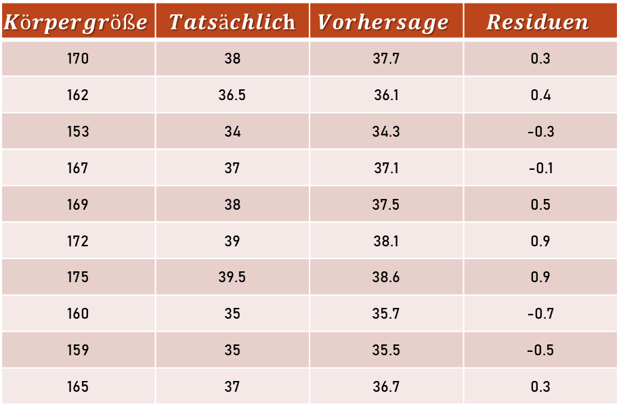
RMSE
Um etwas besser einschätzen zu können wie stark die Abweichung in der Praxis ist, soll auch der RMSE berechnet.
Diesem RMSE entsprechend, wie groß ist der Fehlerbereich in dem wir 68% (vgl. Empirische Regel) unserer Daten erwarten können?
$$Körpergröße$$ | $Tatsächlic$h | $$Vorhersage$$ | $$Residuen$$
170 | 38 | 37.7 | 0.3
162 | 36.5 | 36.1 | 0.4
153 | 34 | 34.3 | -0.3
167 | 37 | 37.1 | -0.1
169 | 38 | 37.5 | 0.5
172 | 39 | 38.1 | 0.9
175 | 39.5 | 38.6 | 0.9
160 | 35 | 35.7 | -0.7
159 | 35 | 35.5 | -0.5
165 | 37 | 36.7 | 0.3
RMSE = 0.55
68 % = +/- 0.55

Slide 79
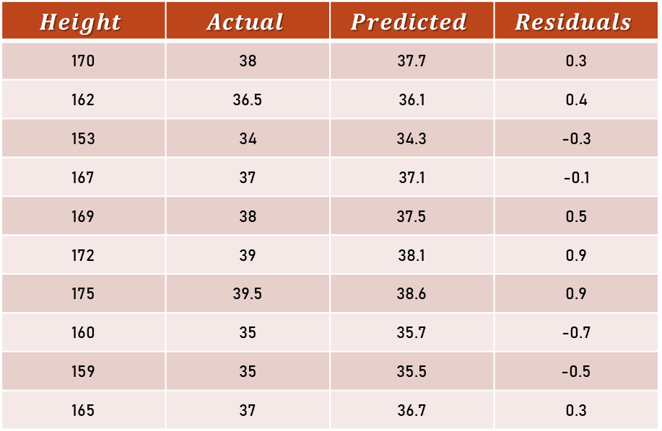
RMSE
In order to be able to estimate a little better how well the regression works, you want to calculate the RMSE.
According to this RMSE, what is the error range in which we can expect 68% (cf. Empirical Rule) of our data?
$$Height$$ | $$Actual$$ | $$Predicted$$ | $$Residuals$$
170 | 38 | 37.7 | 0.3
162 | 36.5 | 36.1 | 0.4
153 | 34 | 34.3 | -0.3
167 | 37 | 37.1 | -0.1
169 | 38 | 37.5 | 0.5
172 | 39 | 38.1 | 0.9
175 | 39.5 | 38.6 | 0.9
160 | 35 | 35.7 | -0.7
159 | 35 | 35.5 | -0.5
165 | 37 | 36.7 | 0.3
Calculate the RMSE for the new data set.

Slide 80

RMSE
In order to be able to estimate a little better how well the regression works, you want to calculate the RMSE.
According to this RMSE, what is the error range in which we can expect 68% (cf. Empirical Rule) of our data?
$$Height$$ | $$Actual$$ | $$Predicted$$ | $$Residuals$$
170 | 38 | 37.7 | 0.3
162 | 36.5 | 36.1 | 0.4
153 | 34 | 34.3 | -0.3
167 | 37 | 37.1 | -0.1
169 | 38 | 37.5 | 0.5
172 | 39 | 38.1 | 0.9
175 | 39.5 | 38.6 | 0.9
160 | 35 | 35.7 | -0.7
159 | 35 | 35.5 | -0.5
165 | 37 | 36.7 | 0.3
RMSE = 0.55
68 % = +/- 0.55

Slide 81
RMSE
In order to be able to estimate a little better how strong the deviation is in practice, the RMSE is also to be calculated.
According to this RMSE, what is the error range in which we can expect 68% (cf. Empirical Rule) of our data?
$$Height$$ | $$Actual$$ | $$Prediction$$
170 | 38 | 37.7
162 | 36.5 | 36.1
153 | 34 | 34.3
167 | 37 | 37.1
169 | 38 | 37.5
172 | 39 | 38.1
175 | 39.5 | 38.6
160 | 35 | 35.7
159 | 35 | 35.5
165 | 37 | 36.7
Berechne für den neuen Datensatz den MSE & MAE.

